Slide 1

Crude Oil Price Prediction
Group : 5
Mentor : Aishwarya Mate

Slide 2


Team Members
Ayesha Shaikh
Ayush Shah
Amit Pehere
Rameshwar Jaiswal
Prasanna Khandare
Rohit Padale

Slide 3

Objective
Oil is a commodity notorious for being able to go in the complete opposite direction after a single market event.
This is because the fundamentals of oil price are rarely based on real-time data, instead, it is driven by externalities making our attempt to forecast it even more challenging.
As the economy will be highly affected by oil prices. Our model will help to understand the pattern in prices to help the customers and businesses to make smart decisions.

Slide 4

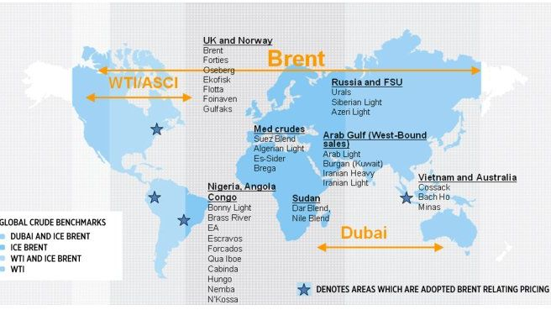
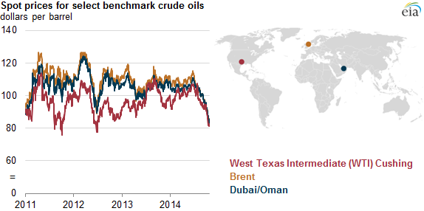
A benchmark crude is a crude oil that serves as a reference price for buyers and sellers of crude oil.
There are three primary benchmarks
West Texas Intermediate (WTI)
Brent Blend
Dubai Crude.

Slide 5

Project Flow

Slide 6
Data Collection

Slide 7
We extract data from Quandal Library.
Quandal is a platform that offers economic, financial, and alternative datasets to its users.

Slide 8
Dataset
Downloaded the Brent oil price dataset from U.S. Energy Information Administration (EIA) website.
Dataset consist of 3rd Oct 2016 to 22nd Nov 2021 (5 years) of daily oil price.

Slide 9


Exploratory Data Analysis (EDA)

Slide 10
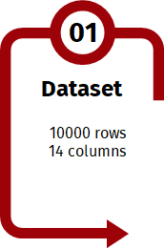
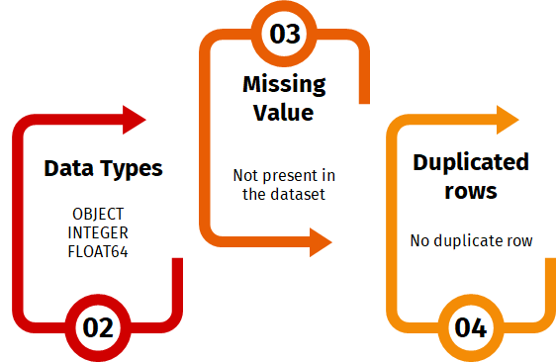
Inferences from Data-Set
1309 Rows
2 Columns
Datetime
Float

Slide 11
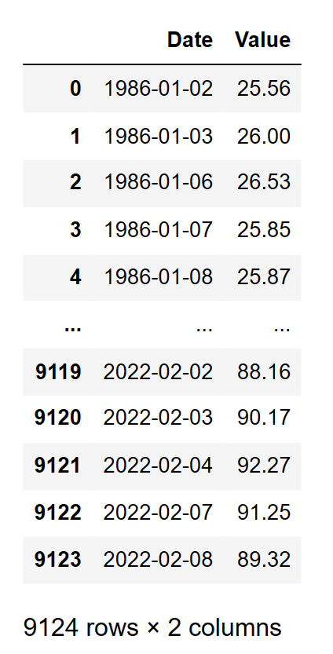
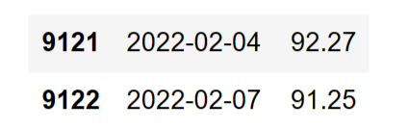
In the left side image in this same slide, we have noticed that, the Dataset doesn’t contain the values for Saturday and Sunday.
For example, if you look closely at 5th and 6th February (Saturday & Sunday), we can see that they are missing, and this all because the Oil Market is closed on weekends.

Slide 12
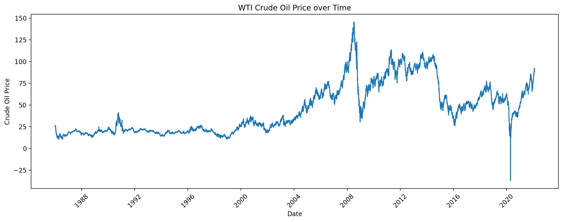
From the above Line Graph, we can say that the Crude Oil Prices has tend to show an UPWARD trend from 1987 till 2007.
In the Year 2008, the Great Recession occurred and then Oil Prices dropped suddenly.
After the Great Recession, Oil Prices started to rise till the year 2011.
Then from 2011,Oil Prices were dropping dramatically towards 2015.
From year 2015 onwards, the Oil Prices seem to fluctuate with some peaks and falls till the 2020 Pandemic Year.
From year 2021 till present it is showing a Growing Trend.

Slide 13
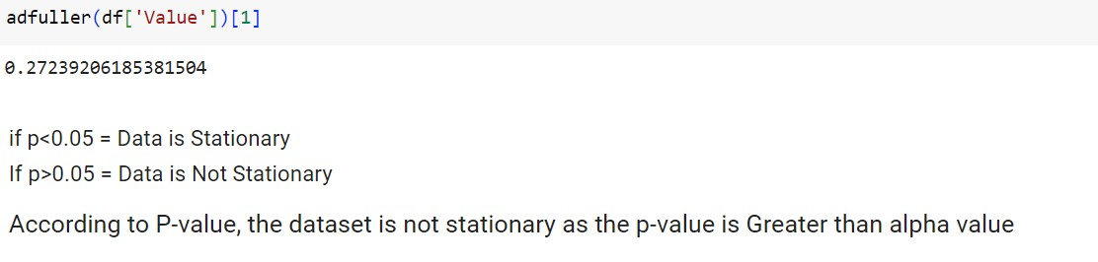
Stationarity:
Data is not stationary.

Slide 14
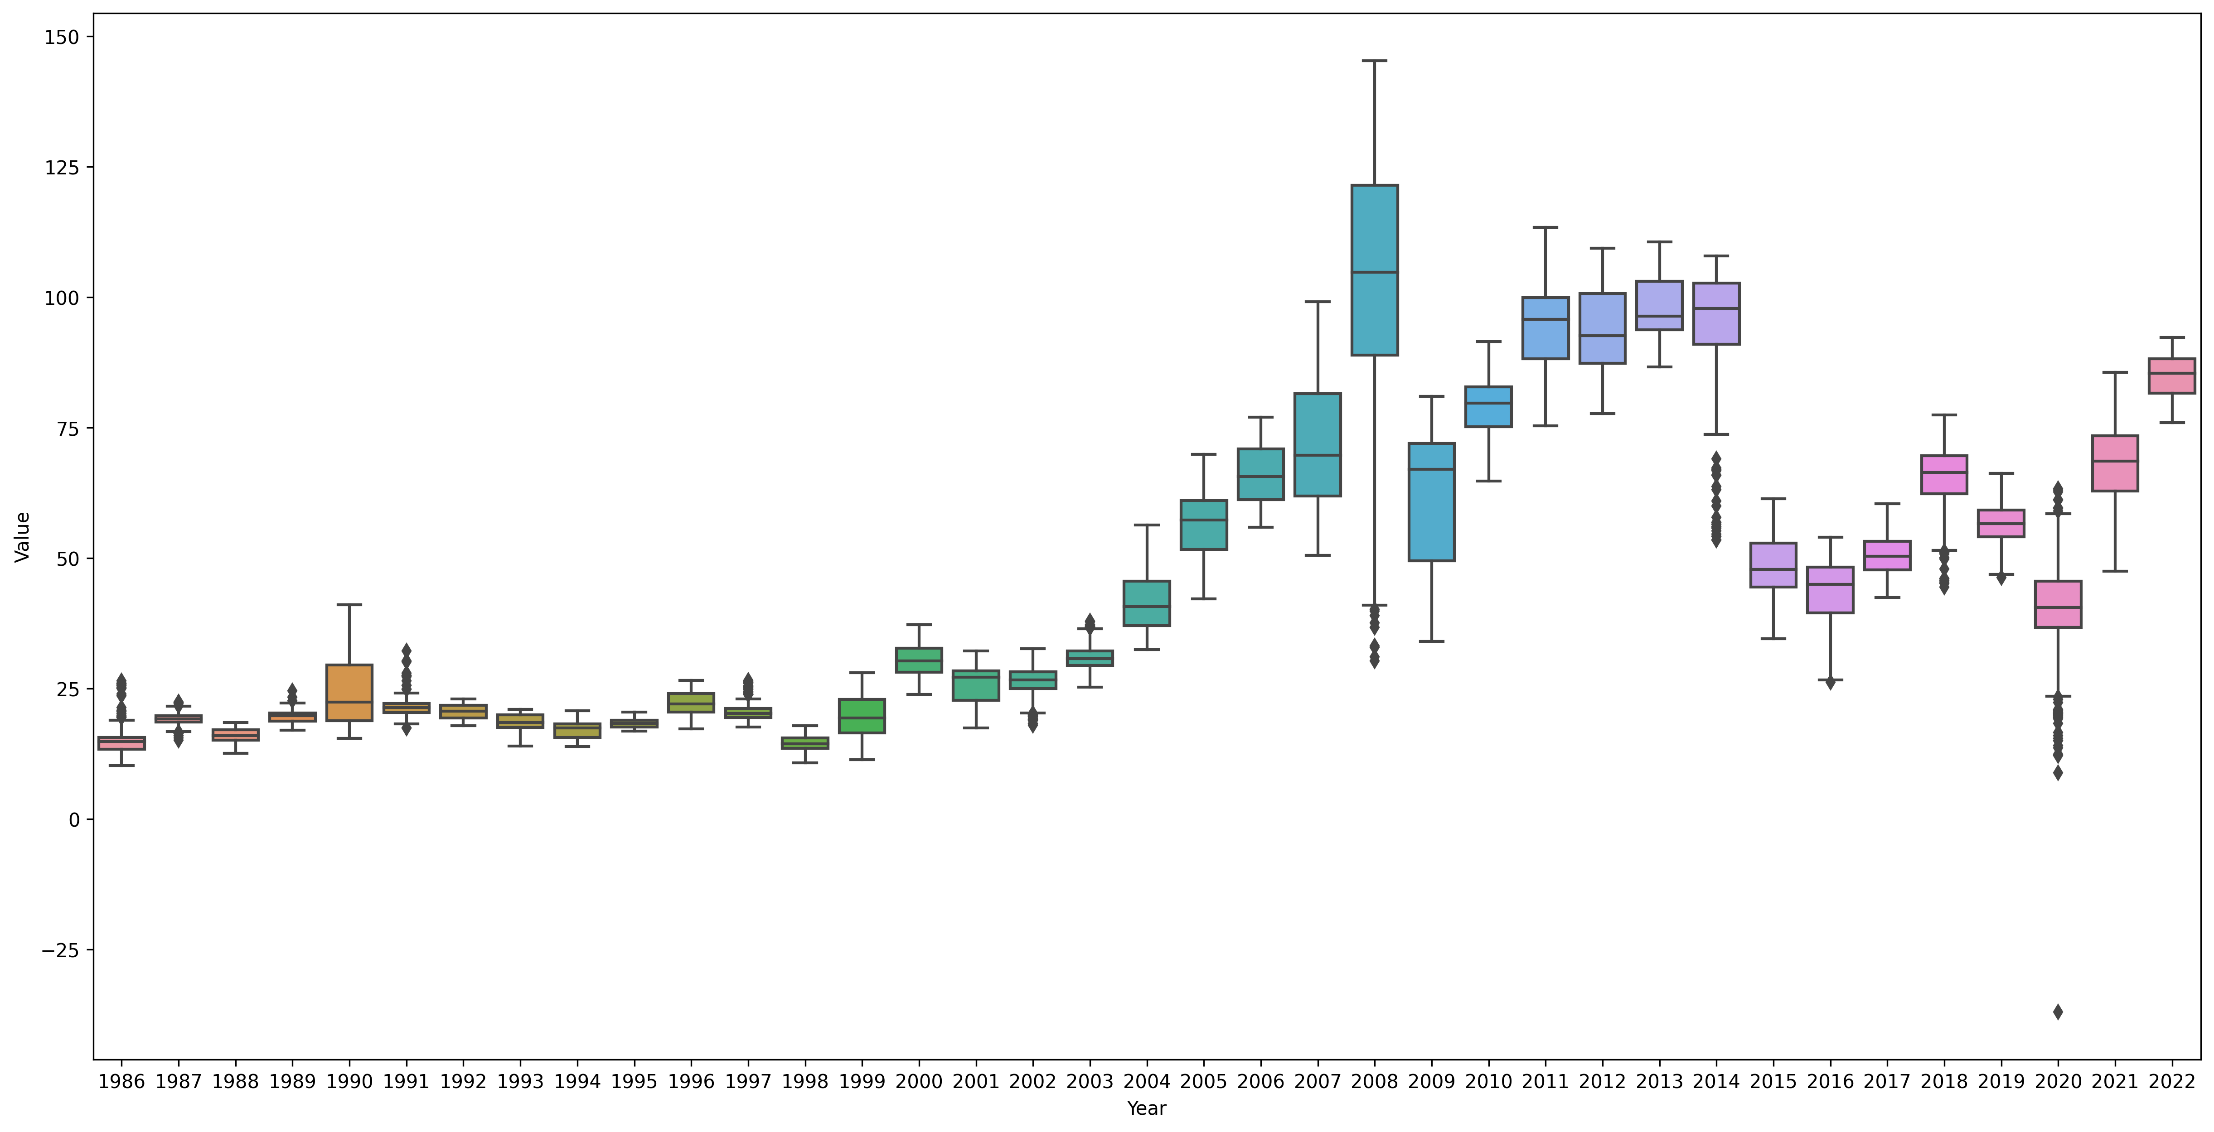
We can see the oil price range by year and month.
Most of the years except 2008, 2014, and 2022 The box plot is comparatively short, meaning less fluctuation in terms of price.
In the year 2008, the box plot is comparatively tall, showing high fluctuations in price.

Slide 15
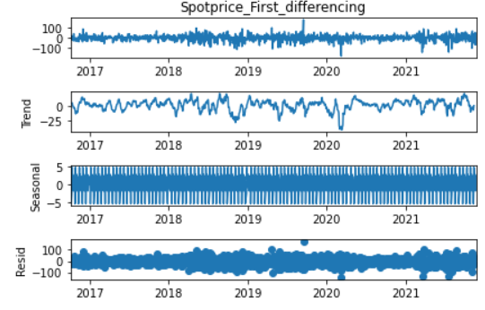
Decomposition plot after Differencing

Slide 16
Partition Series

Slide 17
Splitting the data into test and train
The final data after data processing was split into train data and test data
Training Data :1083 (3rd Oct 2016 to 31st Dec 2020)
Test Data :226 (1st Jan 2021 to 22nd Nov 2021)

Slide 18
Model Building
Model | Order | Mape Value
ARIMA | 0,1,0 | 4.33921
SARIMA | 0,1,0,5 | 1.12060
LSTM | - | 70.17022
The Forecast model was build based on SARIMA Model has it gives the least MAPE value

Slide 19
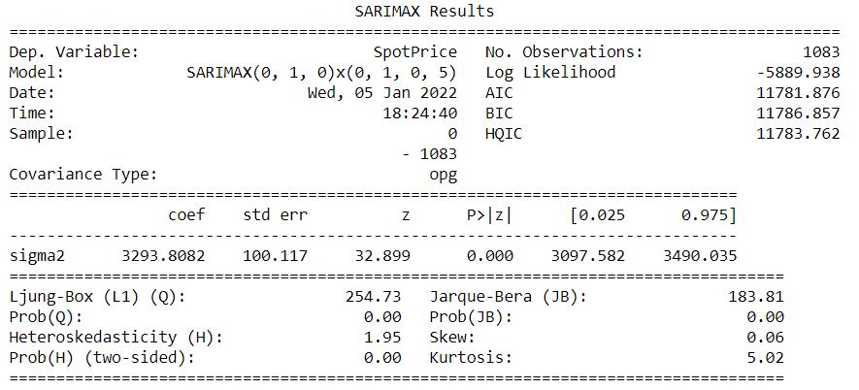
SARIMA Model Summary

Slide 20
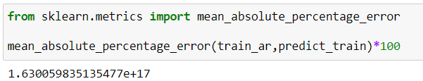

Train MAPE Value
Test MAPE Value

Slide 21
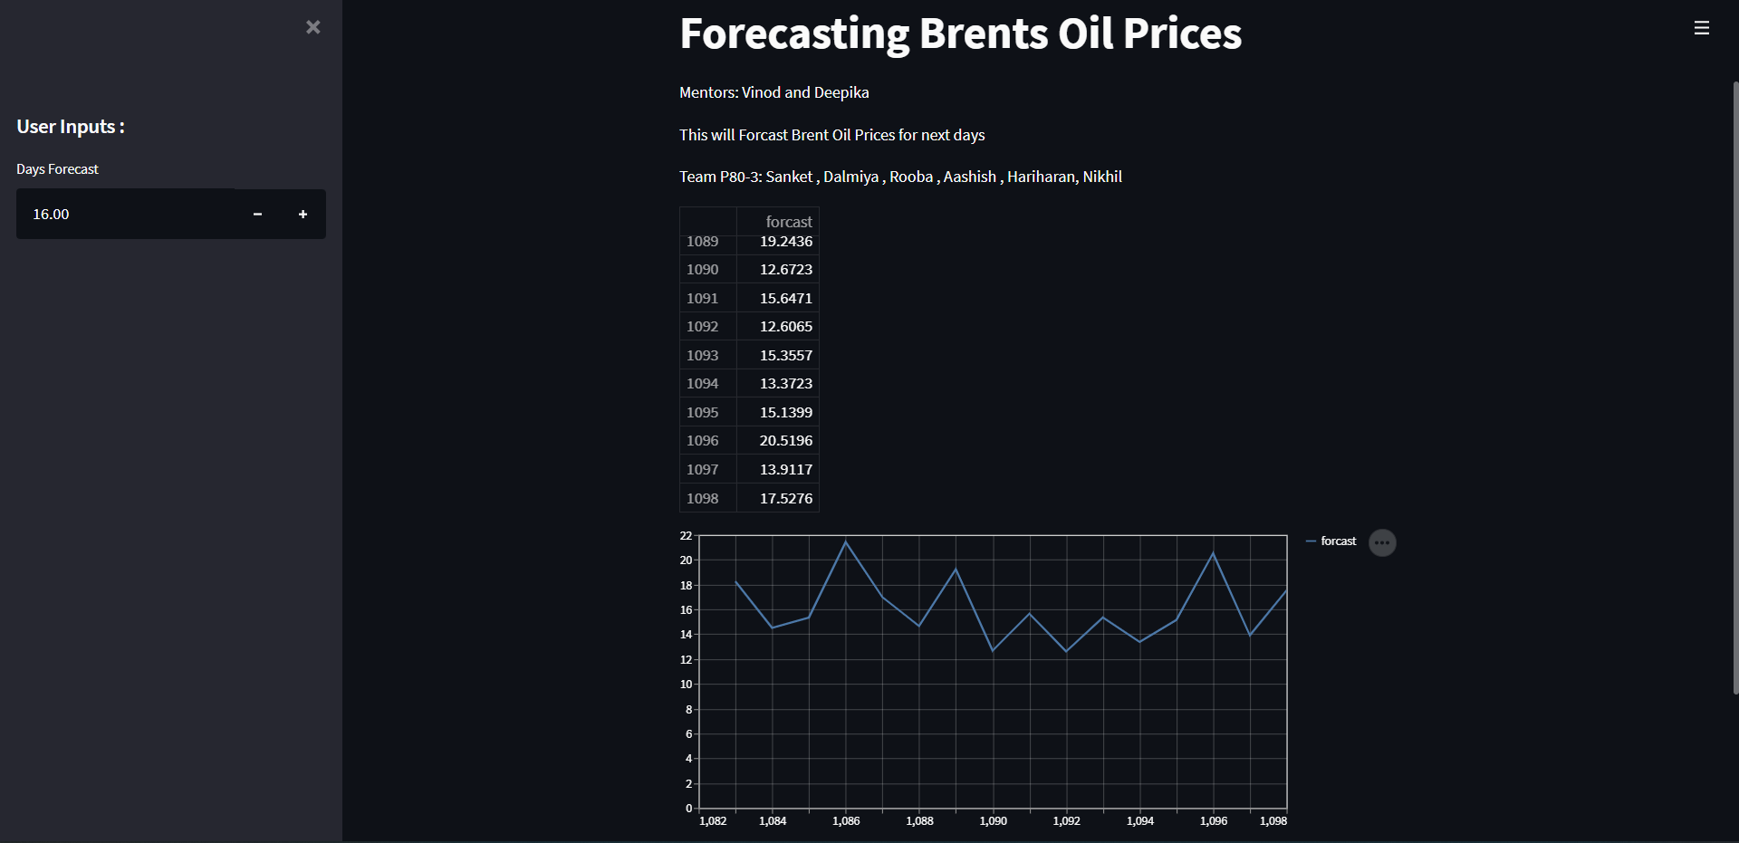
Model Deployment Using Streamlit

Slide 22
CHALLENGES FACED
Webscrapping
Eliminating Outlier
CHALLENGES
Model Building
Increasing Model accuracy

Slide 23
CONCLUSION AND IMPROVEMENTS
It can be inferred that on the whole a SARIMA Model provides the best result in terms of accuracy for the given dataset.
Outliers in the data have been removed using box cox method for better accuracy and better forecasting result.
To make the data stationary , differencing method gave the least p-value.
The above improvements have helped in getting a good accuracy for the final model.

Slide 24
Thank You

